Slide 1

SAP Build Training for Corporate Professionals
DAY-11
www.anubhavtrainings.com

Slide 2


DISCLAIMER
The training content and delivery of this presentation is confidential, and cannot be recorded, or copied and distributed to any third party, without the written consent of Anubhav Trainings

Slide 3
Agenda
Mass order
Testing Scenario
Scenario
Invoice approval
PDF Extraction
PDF Extractions
Template
IRPA Document template

Slide 4




















Slide 5

The Scenario – Invoice Approval
Sonia is working at Anubhav Trainings finance department; every we create and send invoices to the customer. Her job is to check the invoices, especially the amount and module name for each invoice and validate if the payment has been received in the bank account.
Currently she has to open every invoice manually and read the invoice amount, date and course name and validate the date & amount submitted by internal sales team.
She want us to automate this process where the sales team share the invoice details along with date and we need to send approval form only when date match with pdf invoice to Sonia. She reviews the details and provide invoice approval.
On approved an email will trigger to student that their payment has been received for the course.

Slide 6
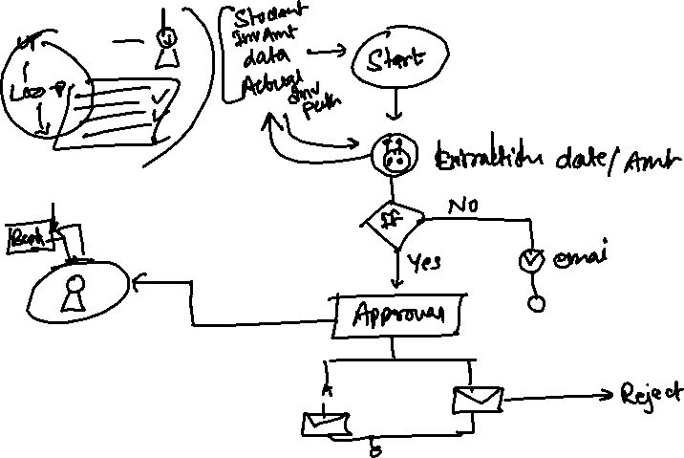
Flow

Slide 7

Document template
The template will define the skeleton of the pdf document which helps RPA component (bot) to understand where which field of data is present. So, at runtime the bot can extract the exact data for us from pixel position of the pdf document.

Slide 8

What We Did
Let’s Summarize
www.anubhavtrainings.com

Slide 9
www.anubhavtrainings.com
Thank You
End of Day 11
www.anubhavtrainings.com

Slide 10



We’re committed to empower you to be
#FutureReady
through powerful training solutions.
We build the workforce of the future.
250+
Corporate Clients
30,000+
Learners Trained
25000+
Learners Placed
FREE WEBINARS
Sign up for free webinars with industry experts every fortnight!
Enroll Now!
Contact us today!
https://anubhavtrainings.com

